Slide 1
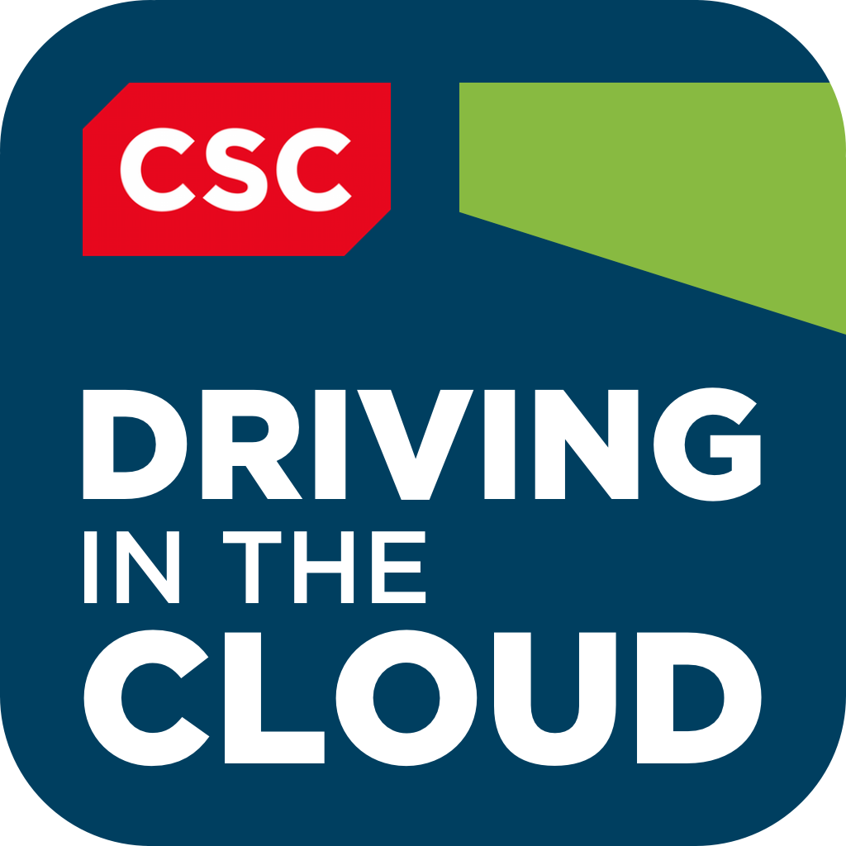

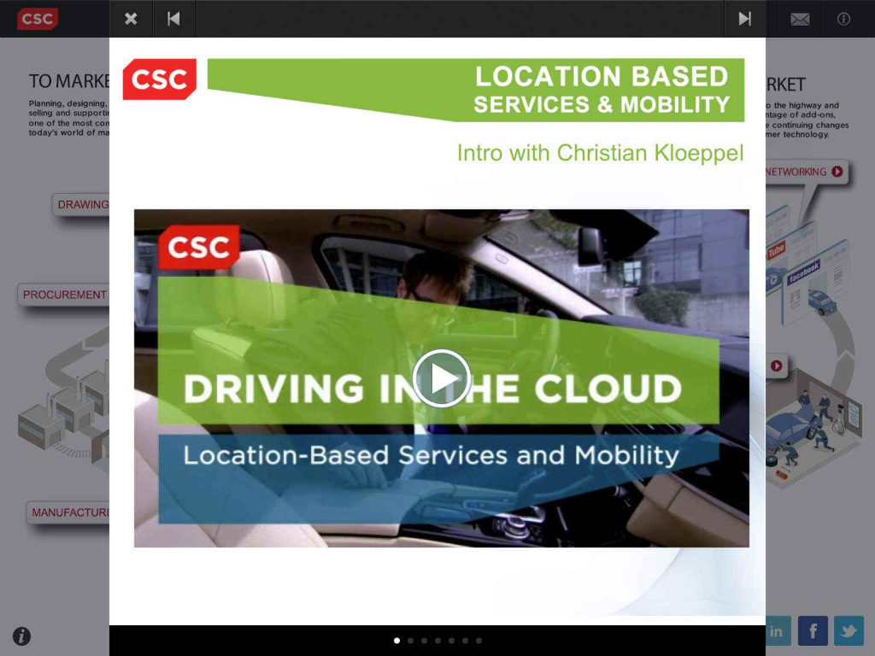
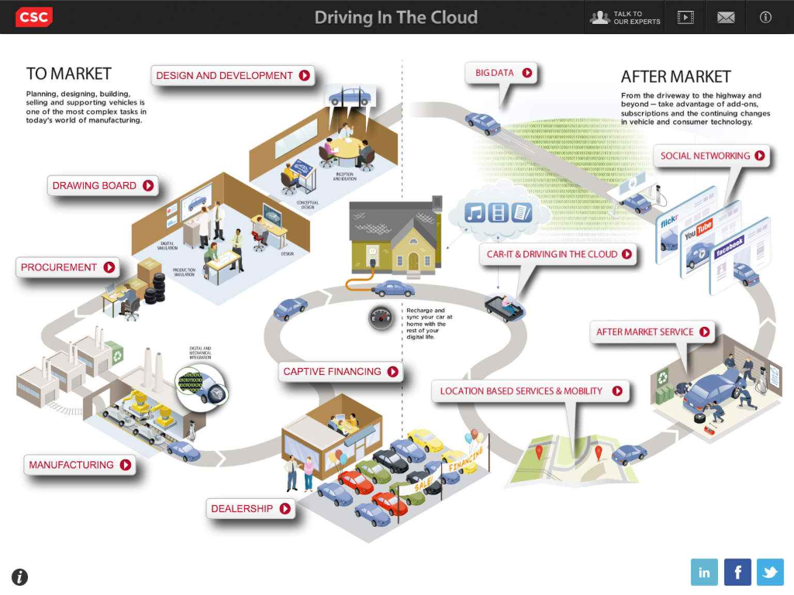
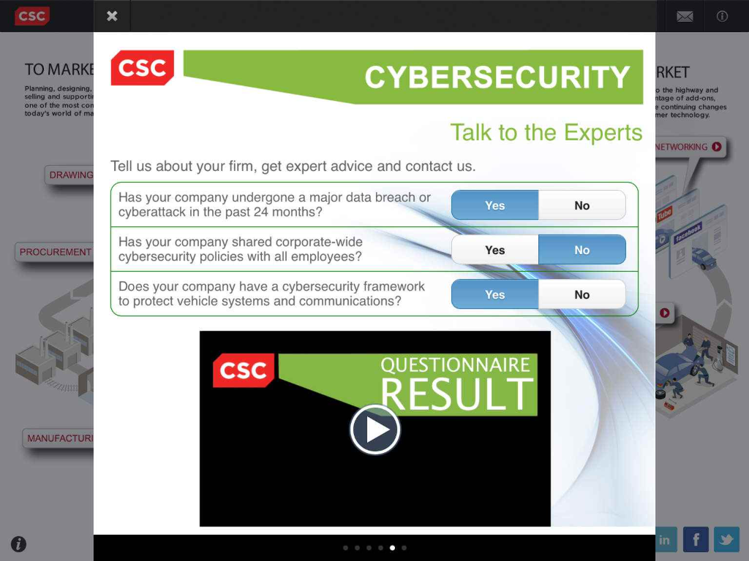
Case Study: CSC – Driving in the Cloud
Client
CSC offers a wide solution portfolio for the car making industry
Challenge
Solution
Results
The aim was to present CSCs capabilities for this market in one place showing todays options, future trends and our view on various car industry topics
Offer the possibility of an assessment to get feedback from professionals
Offer solution and success stories within the app
The driving in the cloud application shows documents, videos and surveys presenting CSCs know how on car IT
In the apps Medialounge users can view videos on various car IT topics
DocumentHub is another highlight: users can view, print and share PDF Documents on various topics
Due to large file sizes of videos etc, the app features a full offline functionality
Full access on CSCs offerings on car IT
Surveys with feedback from professionals within the app
Users can view documents and videos and take a deep dive at solutions and capabilities on CSCs car IT know how in a convenient, playful way
Visit csc.com/mobility for more information

